Slide 1
Oregon Parks and Recreation Department Grant Presentation

Slide 2
Location of Soda Springs Community Center Park

Slide 3
Mineral Springs Park

Slide 4
Soda Springs Community Center Park
In 2014 the City of Sodaville negotiated a land exchange with the Lebanon Area Habitat for Humanity.
The majority of this land has been designated as a park complete with an approved Conditional Use Permit that was required because of the lands location in a Commercial Zone.
The total land area is approximately .67 acres that is located on 2 levels of fairly flat terrain in the center of the City. This makes it a prime location for sports and Community socialization.
A new Park Logo was created
and chosen in March, 2016.

Slide 5
Why is a new park needed?
The City of Sodaville has no Public Transportation
There are no active Organizations or Programs
There is now a Sport Court but no playground or finished space for other Community activities. Mineral Springs Park is a more natural park that was created on the side of a hill and is unusable for activities.
Today the population is about 350 and there has been an increased interest in living in the small town atmosphere. Close to amenities available in the cities of Lebanon (8 miles) and Sweet Home (11 miles), the large lots, wildlife, and surrounding forest, means the City of Sodaville’s population is growing.

Slide 6
Work completed by citizen planning committee and volunteers
2013
2016

Slide 7
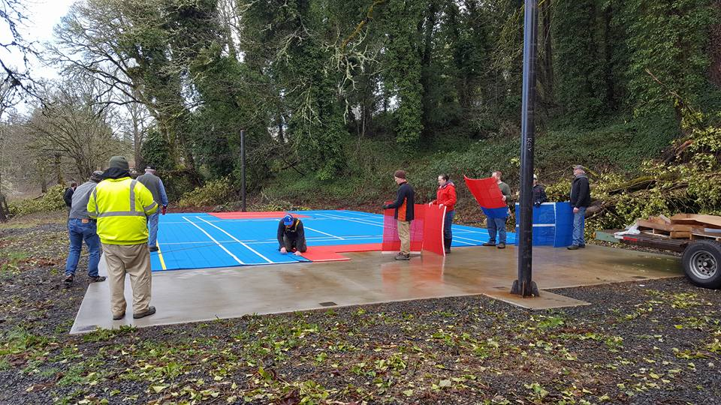
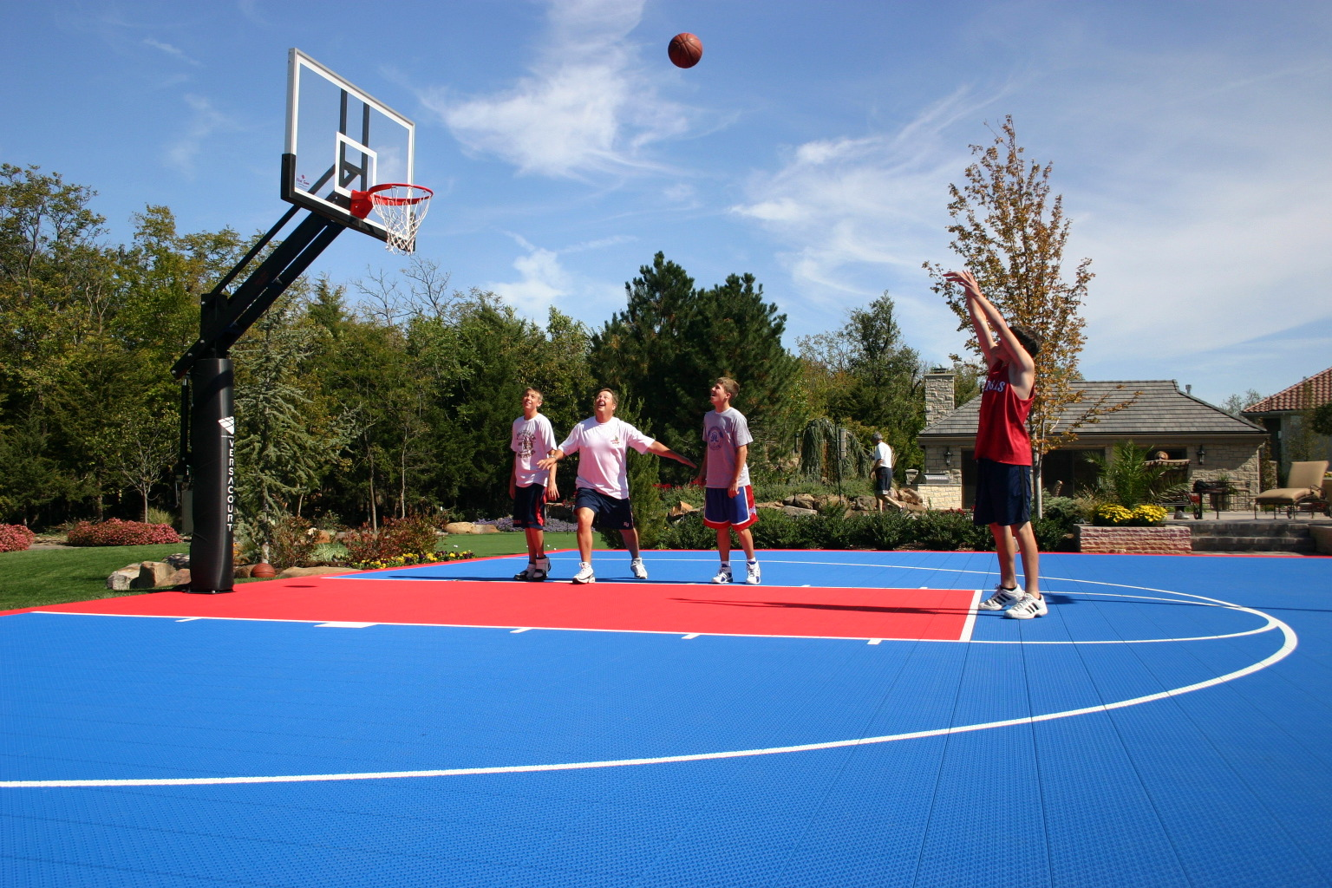
THE CITIZEN PLANNING COMMITTEE AND THE City of Sodaville BUILT A MULTI USE SPORT COURT IN COOPERATION WITH THE FORD FAMILY FOUNDATION AND OTHER GENEROUS DONATIONS. It was built by volunteers.

Slide 8
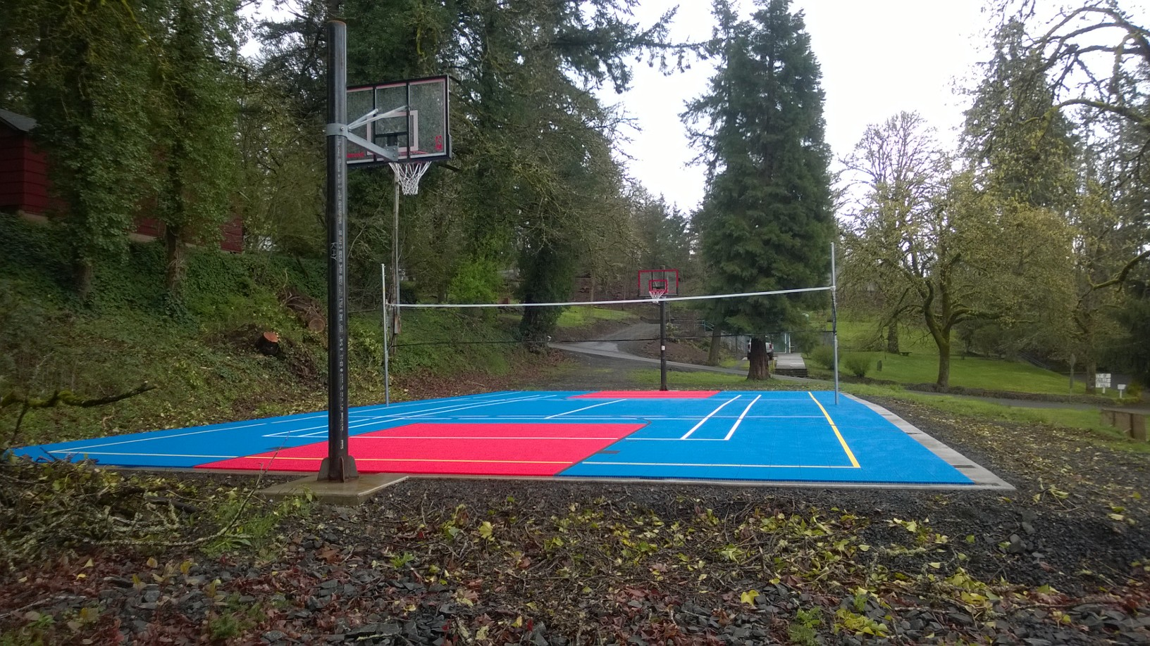
Completed Sport Court

Slide 9
Future soda springs community center park

Slide 10
Future Park Sodaville Road View

Slide 11
Future park Main Street view

Slide 12
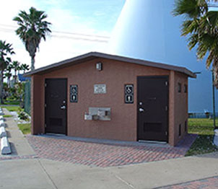
List of Infrastructure Projects funds request
Plumbed 2 Stall ADA Restroom Building
Water Lines
Replace/Install Septic System
Relocating Electrical Utilities
2 Walkways
Parking Facilities with 2 Driveways

Slide 13
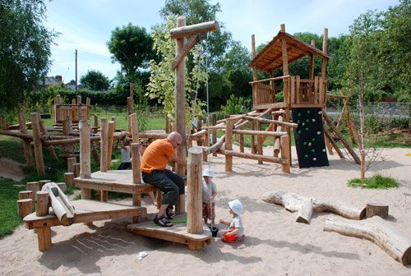
List of projects INVOLVING Education, Socialization, exercise and beautification
Natural Equipped Playground
Horseshoe Pits
Barbeque/Socializing Patio
Park Landscaping

Slide 14
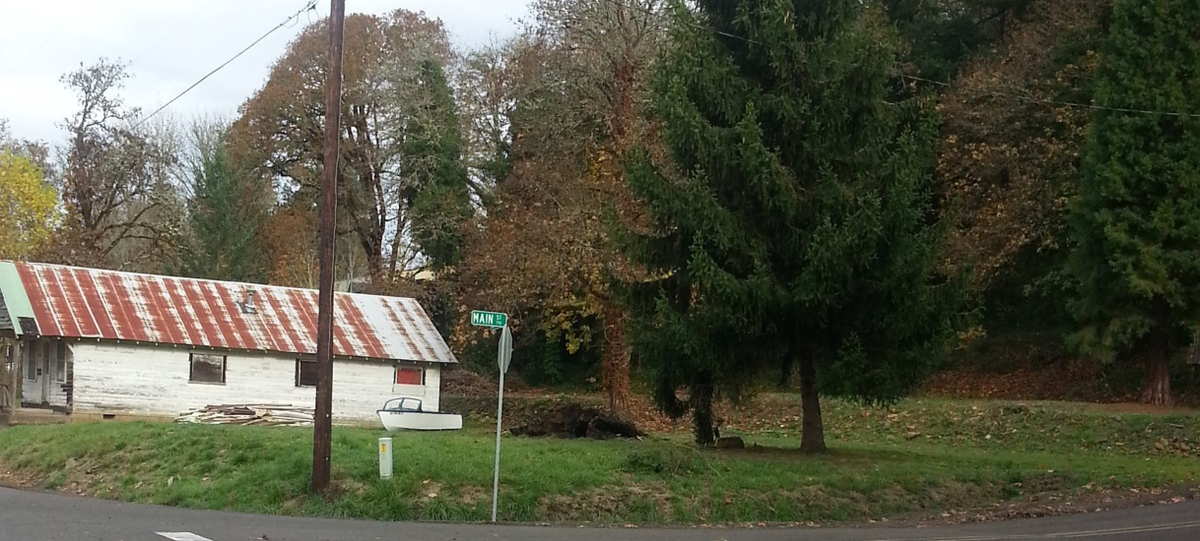
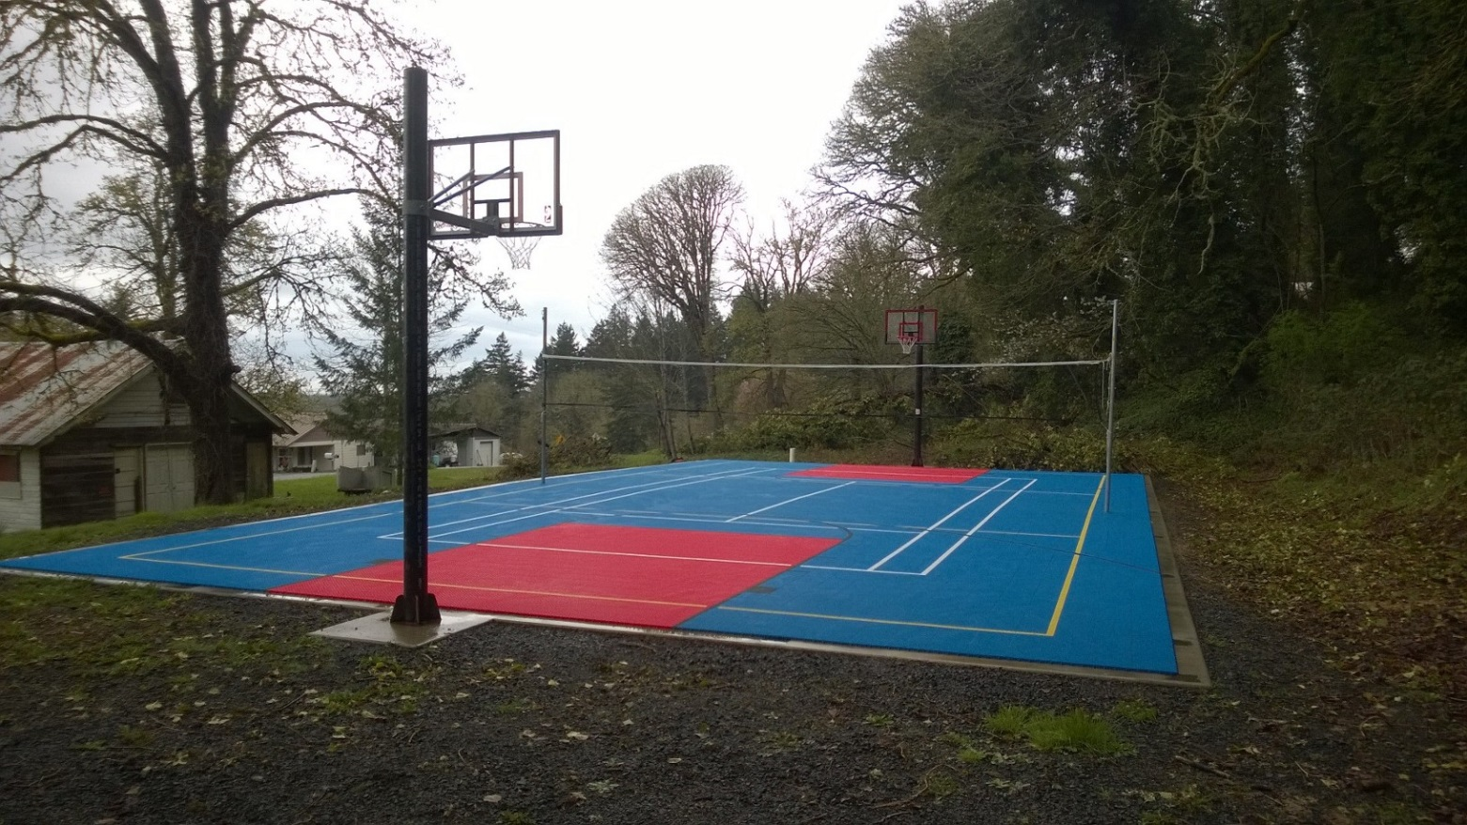
Soda springs community center park

Slide 15
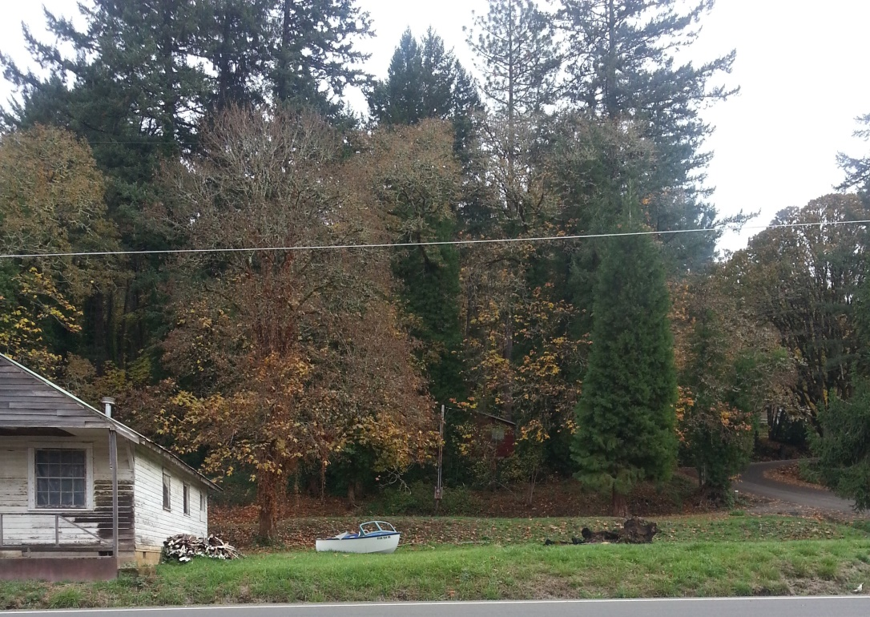
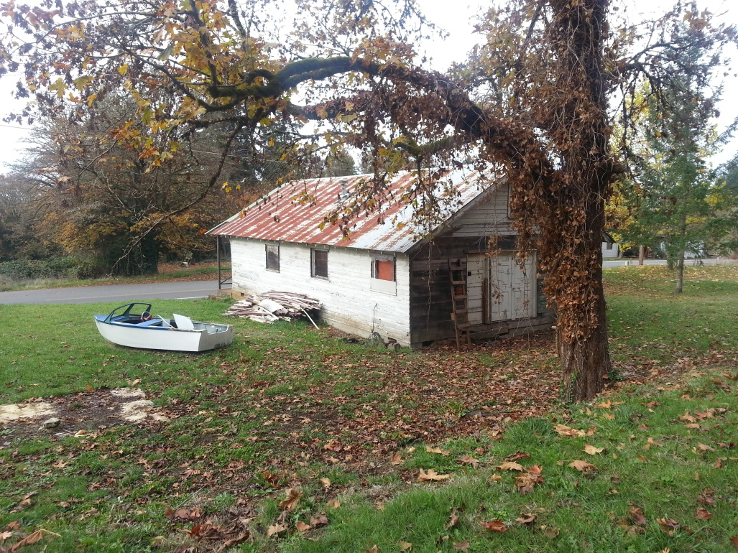

Slide 16
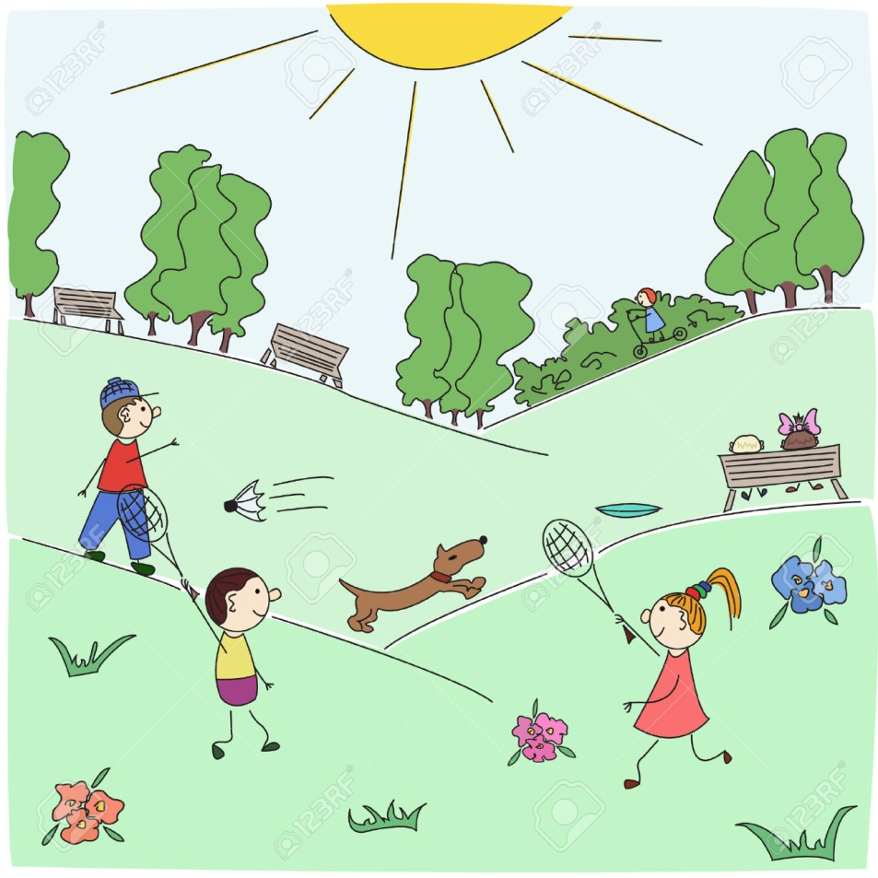
Great Parks Support:
Healthy Child
Development
Quality
Education
Community
Vitality
Sustainable
Environment

Slide 17
THANK YOU FOR YOUR TIME, INTEREST & CONSIDERATION

